Slide 1
MONGODB EDUHUB PROJECT
Empowering EduHub with Scalable, Intelligent Backend Data Infrastructure

Slide 2
Project Objective
End-to-end backend system using MongoDB + PyMongo
Manages users, courses, lessons, enrollments, and assignments
Provides analytics and personalization features
Validates data and handles errors

Slide 3
Project Overview
A portfolio project for Mac-Edu-Hub, a fictional e-learning platform.
Built with MongoDB + PyMongo
Manages users, courses, enrollments, lessons, and assessments
Enables personalized learning and real-time tracking
Supports advanced queries, validation, indexing, and analytics
Powered by clean architecture and modular Python scripts
Project Goal: To create a scalable, insight-driven backend system for online education.

Slide 4
Problem Statement
Challenges in E-Learning Platforms:
✅ EduHub Solves This By:
Poor data structure for scaling content & users
Lack of deep analytics to drive decisions
Inability to personalize learning effectively
Performance bottlenecks from unoptimized queries
Risk of bad data from poor validation
Using MongoDB’s flexibility and power
Enforcing validation and clean data practices
Implementing efficient queries and indexing
Generating actionable insights via aggregation

Slide 5




Design Goals
Scalability :
Built with a flexible schema design to grow with users, courses, and analytics needs.
Maintainability :
Modular Python scripts (seed, queries, analytics, etc.) to separate concerns
Performance :
Indexed key fields (email, course title) for slow query optimization.
Insight generation :
Aggregation pipelines added for instructor, student, and course performance.

Slide 6




Database Design Schema
Users Collection: Tracks roles (student/instructor), personal info, and activity status.
Courses Collection: Contains course content, tags, categories, and ratings.
Enrollments Collection: Links students to courses with completion status and timestamps.
Assignments, Lessons & Submissions: Embedded within courses to reduce query joins and improve performance.
Schema Validation Rules: Ensures data type, required fields, enums, and email format validation.

Slide 7

CRUD & Modularity Decisions
💾 Insertions (Seeding): Used Faker-generated synthetic data ensures real-world-like testing.
🔄 CRUD Operations: Modular and reusable functions for all basic actions (Add, Read, Update, Delete).
✏️ Soft Delete Logic: User data isn’t dropped—isActive: false ensures safe deactivation.
🔍 Case-insensitive & Partial Queries: Improves usability for course search and user lookup.

Slide 8
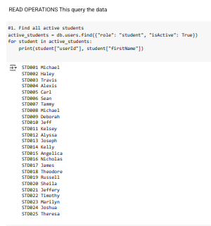
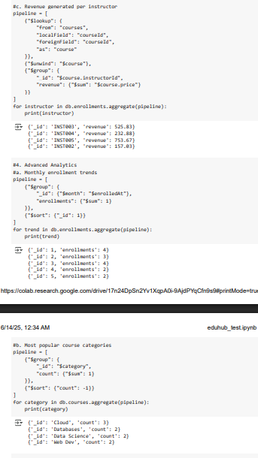
Data Pipeline
We can view the total number of active students currently enrolled
By viewing instructor earnings in the past months, we can make the best paying employee to become “Employee of th e Month”.

Slide 9
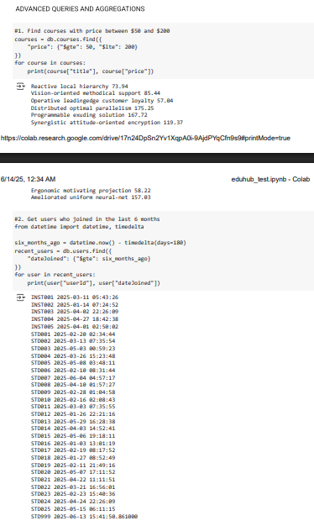
Data Pipeline
By costing the price of courses we can offer to students courses we can identify 8 courses between $50 and $200.
Retrieving students and instructors who have joined the business in the past 6 months are a total of 31 individuals.

Slide 10
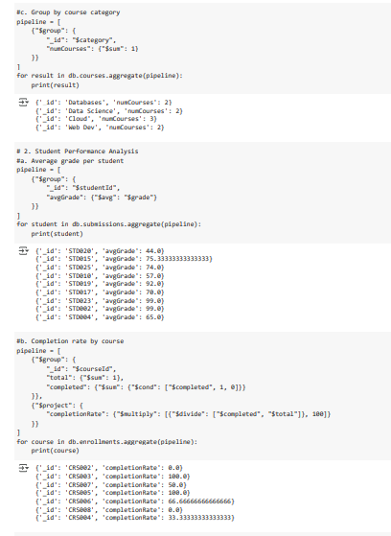
Data Pipeline
By grouping the courses offered based on course category, we have Databases, Data Science, Cloud and Web Dev
We can get Student Performance analysis, average grade per students and understand the students performance since taking in the course
The completion rate for the courses let’s us know how students complete courses.

Slide 11
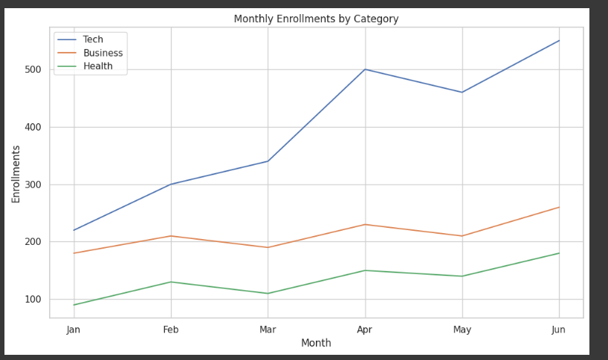
Table
The total number of student enrollments in the past 6 months can help us know the course category with the most enrollments. With Tech courses leading with the highest number of new students enrollment.

Slide 12
Conclusion MongoDB proved ideal for flexible data modeling and rapid iteration. The platform can now track performance, scale user activity, and drive business decisions. Clear pathways for student personalization and educator incentivization have been uncovered.

Slide 13
Thank You

